Slide 1
Financial Planning Overview
VISHAL DALAL – Certified Financial Planner, Fin BluePrint

Slide 2
Contents
Introduction
What is Financial Planning?
Process for creating a Financial Plan
Components of a Plan
Other Aspects
Common Misconceptions
Selecting the right person for creating a Financial Plan
Commercials of creating a Plan

Slide 3
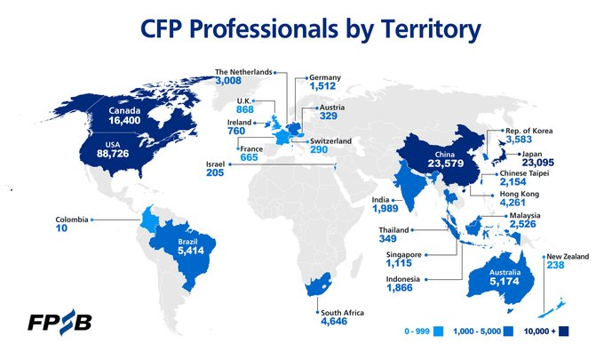
Introduction
Certified Financial Planner - internationally recognized
24+ years corporate experience (17+ in Fortune 500 banks)
Achieved FIRE, quit corporate job in Dec’23 @ age of 47

Slide 4
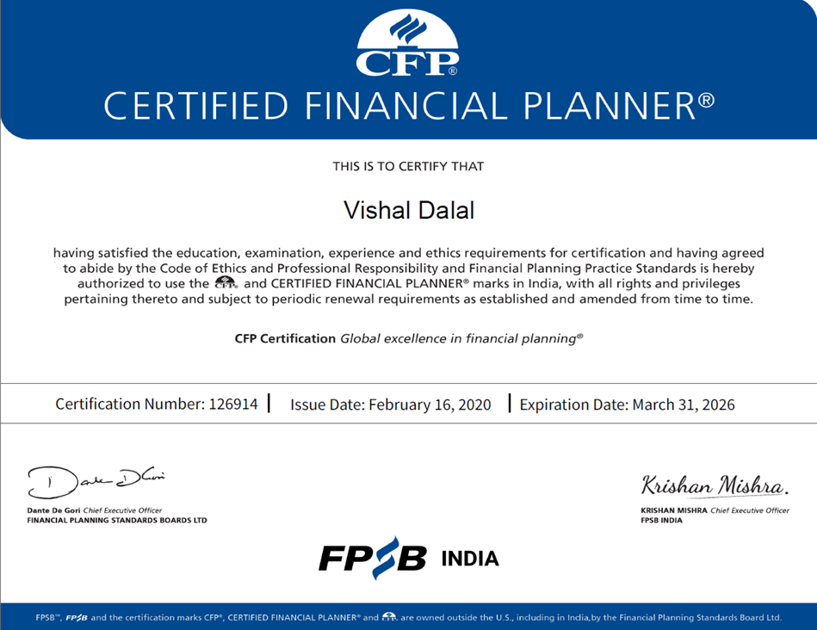

Slide 5
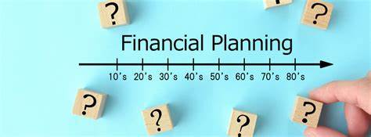

What is Financial Planning?
    Structured and methodical approach to meet one’s financial goals
    Acts as a financial guide as you go through life’s journey
    Covers risk management and aligns returns with risk
    Provides an easy way to track actuals vs projections year-on-year
    Allows for a dynamic ‘what-if scenario’ analysis to determine the impact of ad-hoc or unplanned decisions
    The end-result of a financial planning exercise is a financial plan

Slide 6
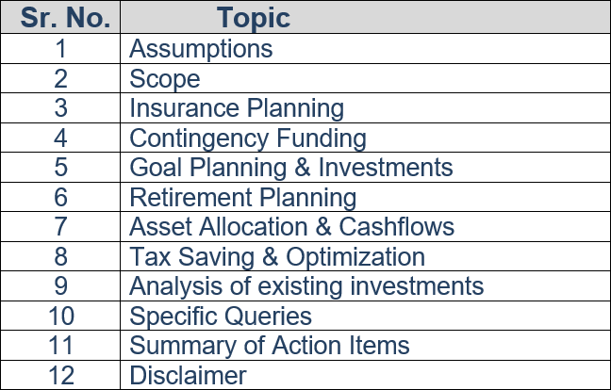
What does a financial plan cover?

Slide 7
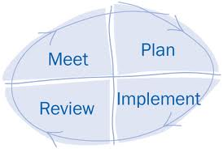
Financial Planning Process
Step 1
Step 2
Data Collection
Goal setting
Current Analysis
Draft Plan
Final Plan
Product Suggestions
Step 4
Step 3
Monitoring
Query Solving
Execution
Follow ups

Slide 8
Data Sheet
    What is a Data Sheet
    Critical document that needs to be filled in by the recipient
    Provides the initial data required to commence financial planning
  Key Sections of the Data Sheet (provided by recipient)
    Financial Goals
    Income
    Expenses
    Assets
    Liabilities
    Risk-taking ability based on subjective queries in the data sheet

Slide 9
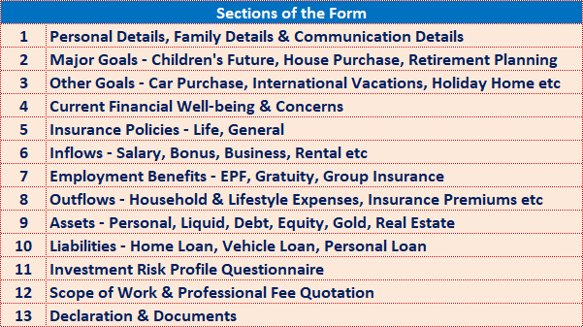
Data Sheet Detailed Sections

Slide 10
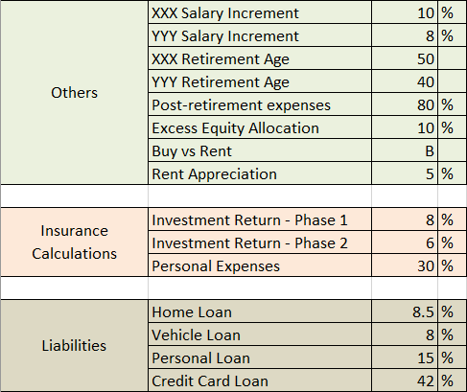
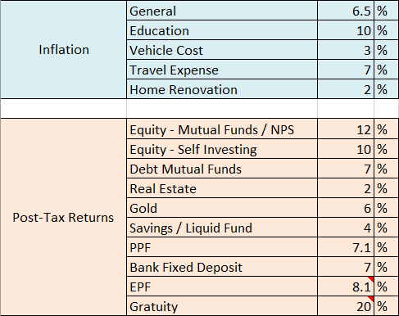
Assumptions
    Assumptions are required to be able to create a plan
      External Factors: Inflation, Return on investments, Govt laws
      Partially Controllable: Salary Increment, Risk quotient
      Fully Controllable: Retirement Age, Expenses, Asset Allocation

Slide 11

Sample Case Study
Self (43 yrs), Spouse (39 yrs), Son (11 yrs)
Assumed Life-Span: 85 years for self
Financial Goals assumed @ ‘then’ costs, except where stated
  Son’s Graduation / Post-Graduation: 10 lakhs (current) / 25 lakhs
  Son’s Marriage: 20 lakhs
  Retirement Age: 55 yrs (Self) / 40 yrs (Spouse). Would like to retire early if possible
  House Purchase: 1 crore in year 2030. Loan to be availed: 75 lakhs; rest downpayment
  Vehicle purchase in 2030, 21 lakhs. Recurring every 10 yrs thereafter
  Vacation every alternate year post retirement. Budget: 8 lakhs / year. Low Priority
Income
  Self: 31 lakhs / yr post-tax. Increment @ 10% annual
  Spouse: 5 lakhs / yr post-tax. Increment @ 5% annual
Expenses
  Household: 12 lakhs / yr
  Insurance premiums: 75K / yr
Assets
  Equity: 72 lakhs; Fixed Income: 1.28 crores
  Real Estate: 70 lakhs; Gold & Cash: 18 lakhs
Liabilities
  No outstanding loans currently

Slide 12
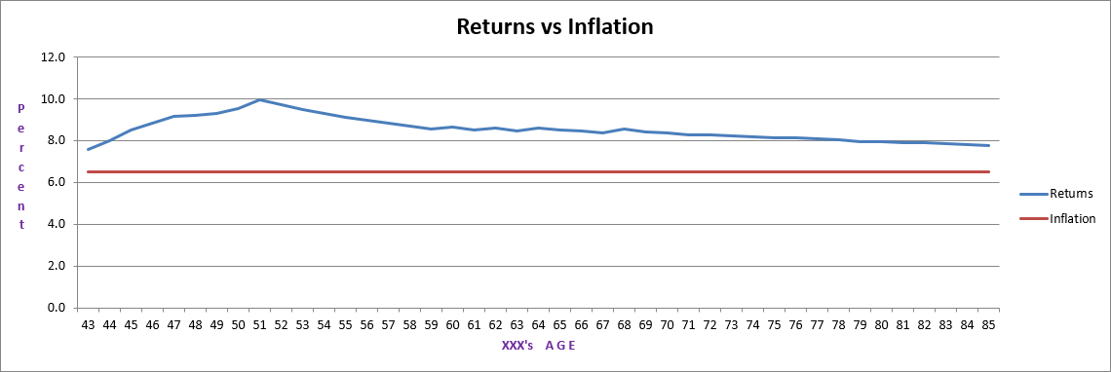
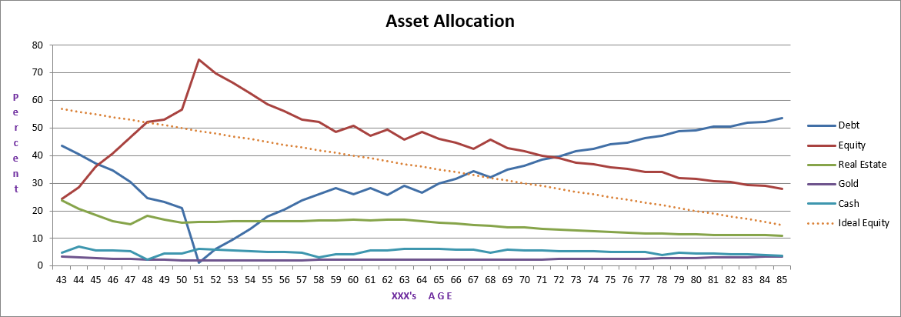
Financial Plan Output Charts (1)

Slide 13
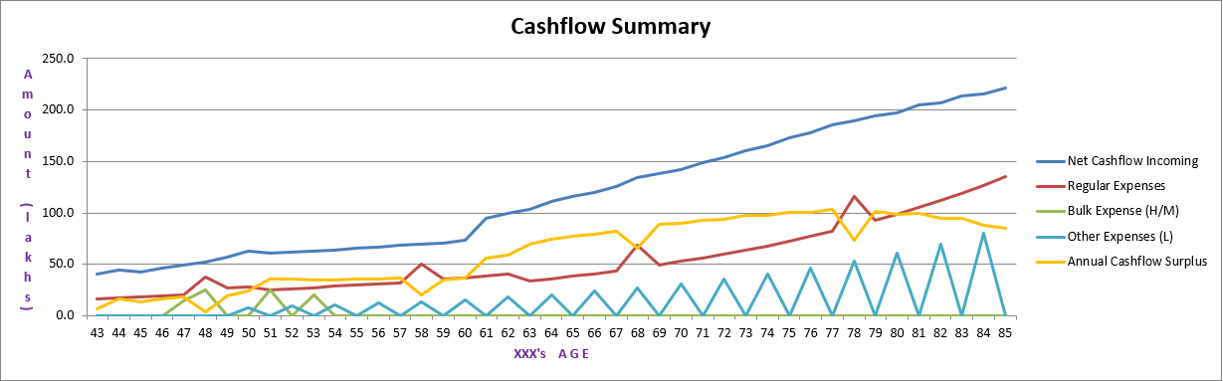
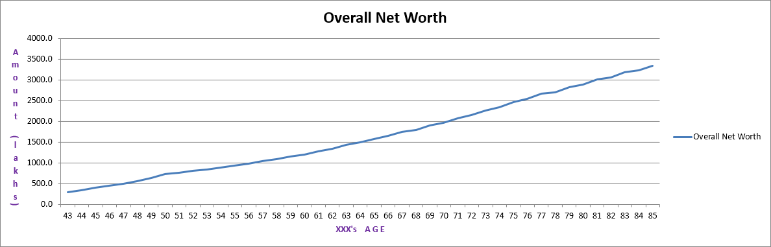
Financial Plan Output Charts (2)

Slide 14
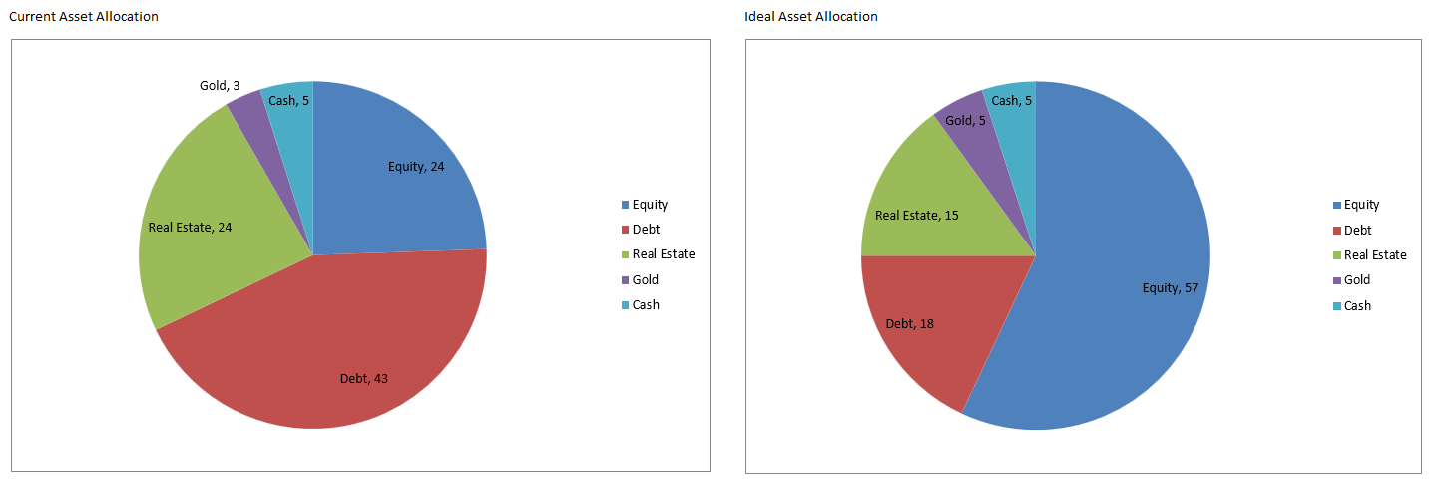
Financial Plan Output Charts (3)

Slide 15
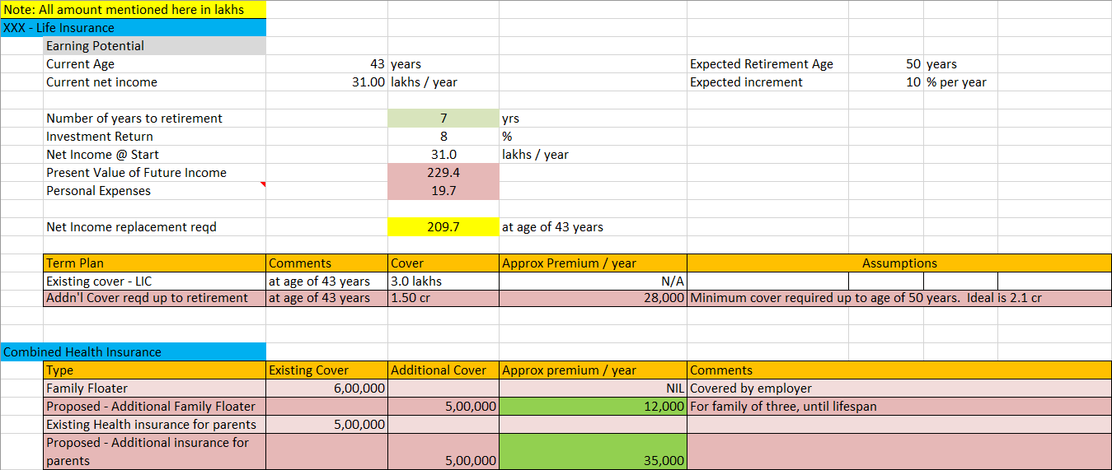
Output cont’d .. Ideal Insurance

Slide 16
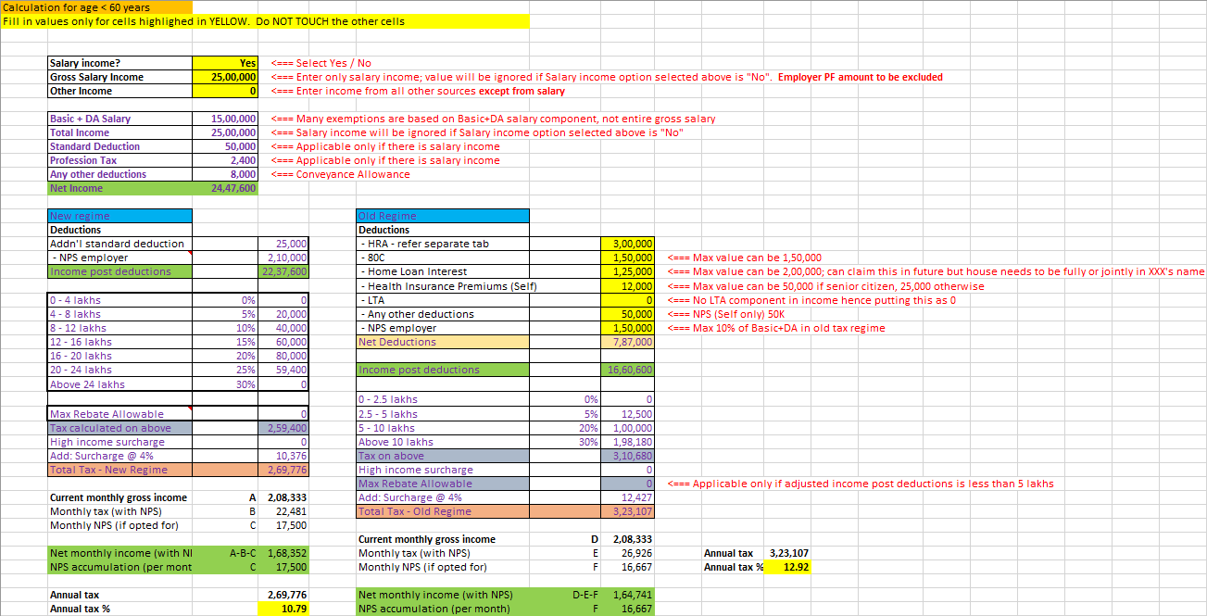
Output cont’d .. Tax Calculation

Slide 17
Other Aspects
    Confidentiality
    All data should be kept 100% strictly confidential
    Sensitive data only via password-protected sheets and PDF’s
    ‘Living’ Document
    Not a one-off activity; life-long process
    Should be reviewed periodically such as semi-annual or annual; or on occurrence of a major life event like marriage, significant investment, etc.
    Coverage
    A good plan should cover not just your existing investments but also future ones and see if those should be stopped, continued or re-allocated

Slide 18


Common Misconceptions
    Financial Planning is for the Rich
    Insurance Planning is Financial Planning
    Tax Planning is Financial Planning
    I am too young to think about Financial Planning
    Confuse Financial Planning with investing

Slide 19
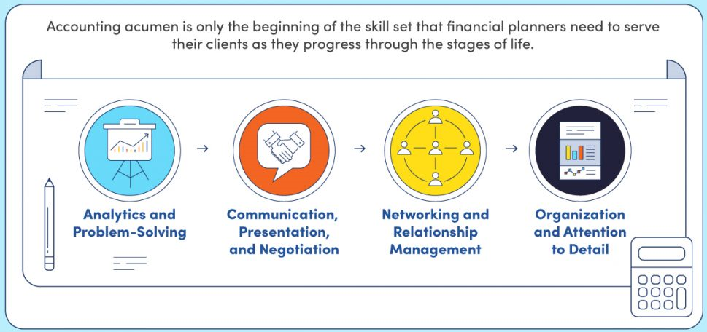
Skills required of a Financial Planner
    Plan creation
    Requires time & effort, skills & knowledge, experience & judgment
    Attention to detail
    Best left to a Certified Financial Planner / Registered Investment Advisor

Slide 20
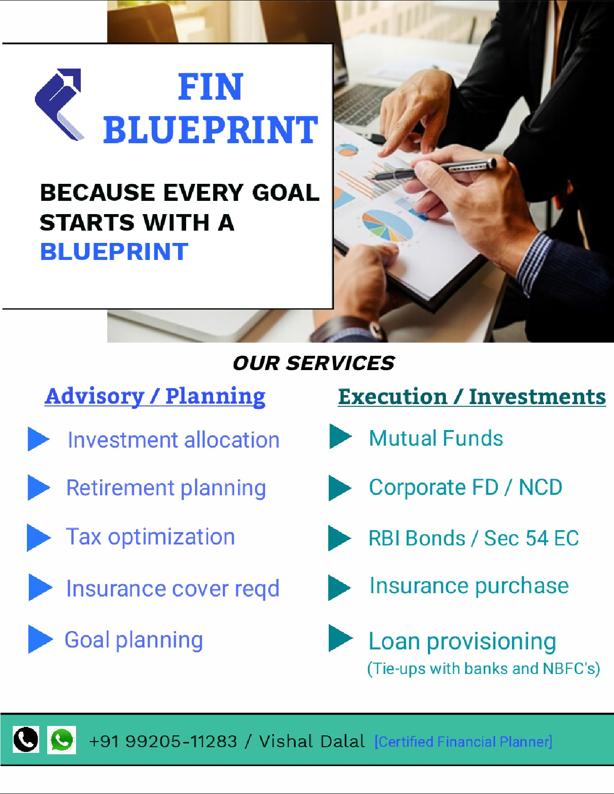
Commercials
    Market
      % of AUM
      Fixed: Initial fee and 50% thereafter on annual basis
    Our Model
      Advisory: 15K / year
      Execution: No charge
    USP
      One-time fee only
      Ask any query anytime
      Prompt response
      DIY Planning Sheet

Slide 21

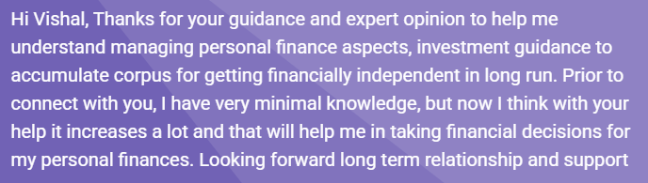


Few Testimonials …

Slide 22

THANK YOU
Contact: +91 99205-11283
Website: www.finblueprint.in
WhatsApp Group: Join

